Slide 1
Selecting Appropriate Apps for Students with Disabilities
Center on Assistive Technology &
Inclusive Education Studies
at The College of New Jersey

Slide 2
Apps, Apps, & More Apps
Overwhelming number of apps available, with new ones released every day
Which ones will benefit my students?
Get recommendations from:
Teachers who have used them with students
Journals, newspapers, websites – not ads, but in-depth descriptions or evaluations of specific apps
Try out apps yourself

Slide 3
Apps in Today’s Workshop
Alternative Access
Augmentative Communication
Behavior Management
Cause & Effect/Switch Training
Emergent literacy
Functional Skills
Handwriting
Keyboarding
Language
Math
Note-taking
Reading/Writing
Reading Instruction
Reading: Books
Visual supports
Miscellaneous

Slide 4
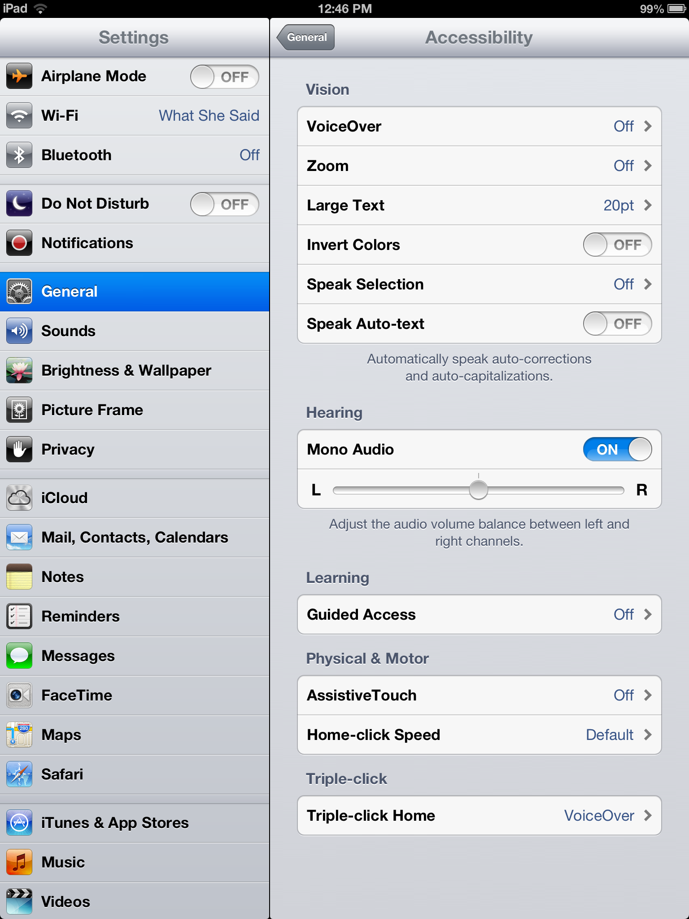
Guided Access

Slide 5
What should I look for?
Framework* for determining which apps are likely to be effective
2 items apply to all categories
Other items apply to instructional apps
Explore
Try
Reflect
*Developed by Harry Walker at Johns Hopkins University, 10/18/2010; edited by Kathy Schrock 2/25/11

Slide 6
User Friendliness
Students &/or adults can launch and navigate within the app independently
Students need only a quick review on how to the use the app
Students need to have the teacher review how to the use the app on more than one occasion
Students need constant teacher supervision in order to use the app

Slide 7
Differentiation/ Customizing
App offers complete flexibility to alter settings & some content to meet student needs
App offers more than one degree of flexibility to adjust settings
App offers only limited flexibility (e.g., a few levels such as easy, medium, hard)
App offers no flexibility: settings cannot be altered to meet student needs

Slide 8
Curriculum Connection
Skill(s) reinforced are strongly connected to the targeted skill or concept
Skill(s) reinforced are related to the targeted skill or concept
Skill(s) reinforced are prerequisite or foundation skills for the targeted skill
Skill(s) reinforced in the app are not clearly connected to the targeted skill

Slide 9
Feedback
Feedback is specific & data is available electronically to student & teacher
Feedback is specific and results in improved student performance (may include tutorial aids)
Feedback is limited to correctness of student responses and only allows student to try again
Feedback is limited to right/wrong

Slide 10
Student Motivation
Students are highly motivated to use the app and select it often
Students will use the app as directed by the teacher
Students view the app as “more schoolwork” and may be off-task when directed to use the app
Students avoid the use of the app or complain when the app is assigned

Slide 11
Reporting
Data is available electronically to the student and teacher
Data is available electronically to the student and may be provided to the teacher via screenshot
Data is available electronically to the student but is not presented on a single summary page
No summary page is available

